Slide 1

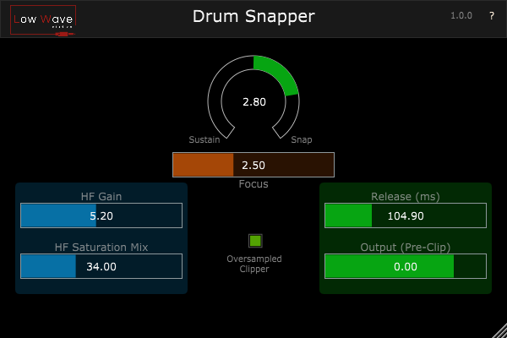
Drum Snapper
Quickstart guide

Slide 2
Drum Snapper
Description
Drum Snapper is a Transient Shaper tailored for drums.
It can add more snap or more sustain to the drums and has other extra functions not found on other transient shapers.
- It has a Focus knob specially made for sharpening the attack of the drum;
- A Tape-like Clipper that is oversampled to avoid aliasing (introduces latency, for best quality);
- With the Release knob it is possible to shape the tail of the drum when adding sustain and change the sensitivity of the processing when adding attack;
- A Tape-like Clipper for distorting high frequencies spikes, with both gain and mix controls. To add excitement.

Slide 3
Drum Snapper
Features
Add Attack / Sustain
High Frequency saturation gain
High Frequency saturation mix
Sharpness of the attack
Oversampled clipper
Output gain (pre-clipper)
Release slider

Slide 4
Drum Snapper
Instalation
On Windows
Copy Drum Snapper folder to:
- Common VST3 folder: C:\Program Files\Common Files\VST3
On macOS
Copy Drum Snapper folder to:
VST3
/Users/admin/Library/Audio/Plug-Ins/VST3
AU
/Users/admin/Library/Audio/Plug-Ins/Components

Slide 5
Drum Snapper
Links
Drum Snapper: https://lowwavestudios.com/drumsnapper/
Patreon: https://www.patreon.com/lowwavestudios
Instagram: https://www.instagram.com/lowwavestudios/
Facebook: https://www.facebook.com/Lowwavestudios

